Slide 1

Emotion detection in It professional by using Image processing and Machine Learning
-presented by
Yekasi swetha

Slide 2
CONTENTS
ABSTRACT
INTRODUCTION
EXISTING SYSTEM
PROPOSED SYSTEM
ALGORITHM
SYSTEM ARCHITECTURE
DATA SET
OUTPUT SCREENS
CONCLUSION

Slide 3
Abstract
Now a days, employee health and well-being is the most important consideration in the work place. Because it will affect the productivity of an individual employee and team contribution. the automatic facial expression analysis using machine learning has become an interesting and active research area from past few decades.
Employee Emotion Detection System (EEDs) has been proposed to automatically detect employee emotions in real time using machine learning. EED system helps the employer can check well-being of employees and identified emotion .

Slide 4
INTRODUCTION
Emotions are one of the basic expressions of people. It is an important part of our non-verbal communication. Emotion recognition generally involves discovering human feelings from facial expressions.
Facial expressions are a general indicator of the mood of all people. The expression tells us a lot about one's modern investigation. In this challenge, a headshot is judged on one of SEVEN specific emotions which are ‘angry’, ‘disguised’, ‘fearful’, ‘happy’, ‘neutral’, ‘sad’ and ‘surprise’.

Slide 5
EXISTING SYSTEM
In the existing system work on stress detection is based on the digital signal processing, taking into consideration Galvanic skin response, blood volume, pupil dilation and skin temperature. And the other work on this issue is based on several physiological signals and visual features (eye closure, head movement) to monitor the Emotion in a person while he is working. However these measurements are intrusive and are less comfortable in real application. Every sensor data is compared with a stress index which is a threshold value used for detecting the stress level.
Disadvantages:
The extracted features explicitly gives the stress index of the physiological signals. The ECG signal is directly assessed by using commonly used peak j48 algorithm.
Algorithm: Bayesian Network, J48.

Slide 6
PROPOSED SYSTEM
The human body can enjoy marked stages of anxiety and suffering in response to difficult situations. Early detection of Emotion symptoms is critical to protecting The domain rule set of the proposed system tool, which includes the KNN classifier, is implemented for compression optimization. Image processing is used in the initial part for detection, the browser presents an image of the agent as input. To get a high-quality image or extract some useful recording, image processing is used by converting the image into a virtual form and performing some operations on it. The input can be an image and the output can be an image or capabilities related to that image
Advantages:
Employee Emotion Detection System has been proposed to automatically detect employee emotions in real time using machine learning.
We will capture images of the employee based on the regular intervals and then the tradition survey forms will be given to the employee.
Algorithm: Knn (K-nearest neighbors)

Slide 7
MACHINE LEARNING ALGORITHM
K-Nearest Neighbors (KNN) is a machine learning algorithm that can be employed for Emotion detection in IT professionals using image processing and machine learning techniques. The approach involves collecting a labeled dataset of IT professionals' images, preprocessing the images, and extracting relevant features such as facial expressions and posture. The KNN algorithm is then implemented to classify new images as stressed or non-stressed by finding the nearest neighbors based on extracted features. Model evaluation is performed using a test dataset, and hyperparameter tuning optimizes the algorithm's performance. The final model can be deployed in real-world applications, assisting in image-based Emption monitoring for IT professionals

Slide 8
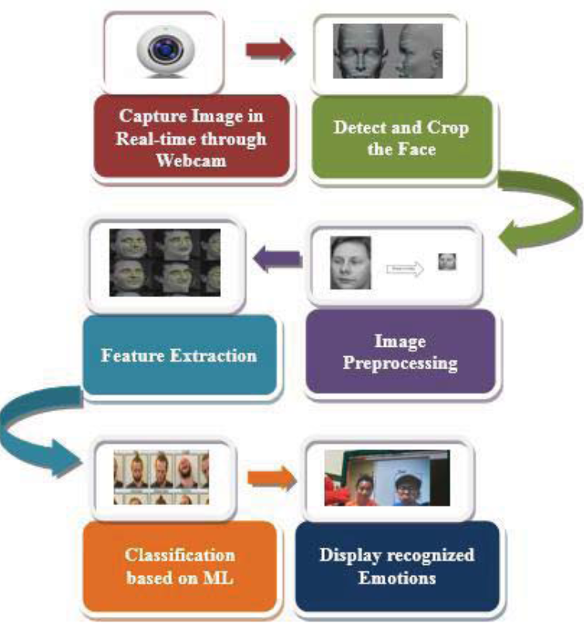
SYSTEM ARCHITECTURE

Slide 9
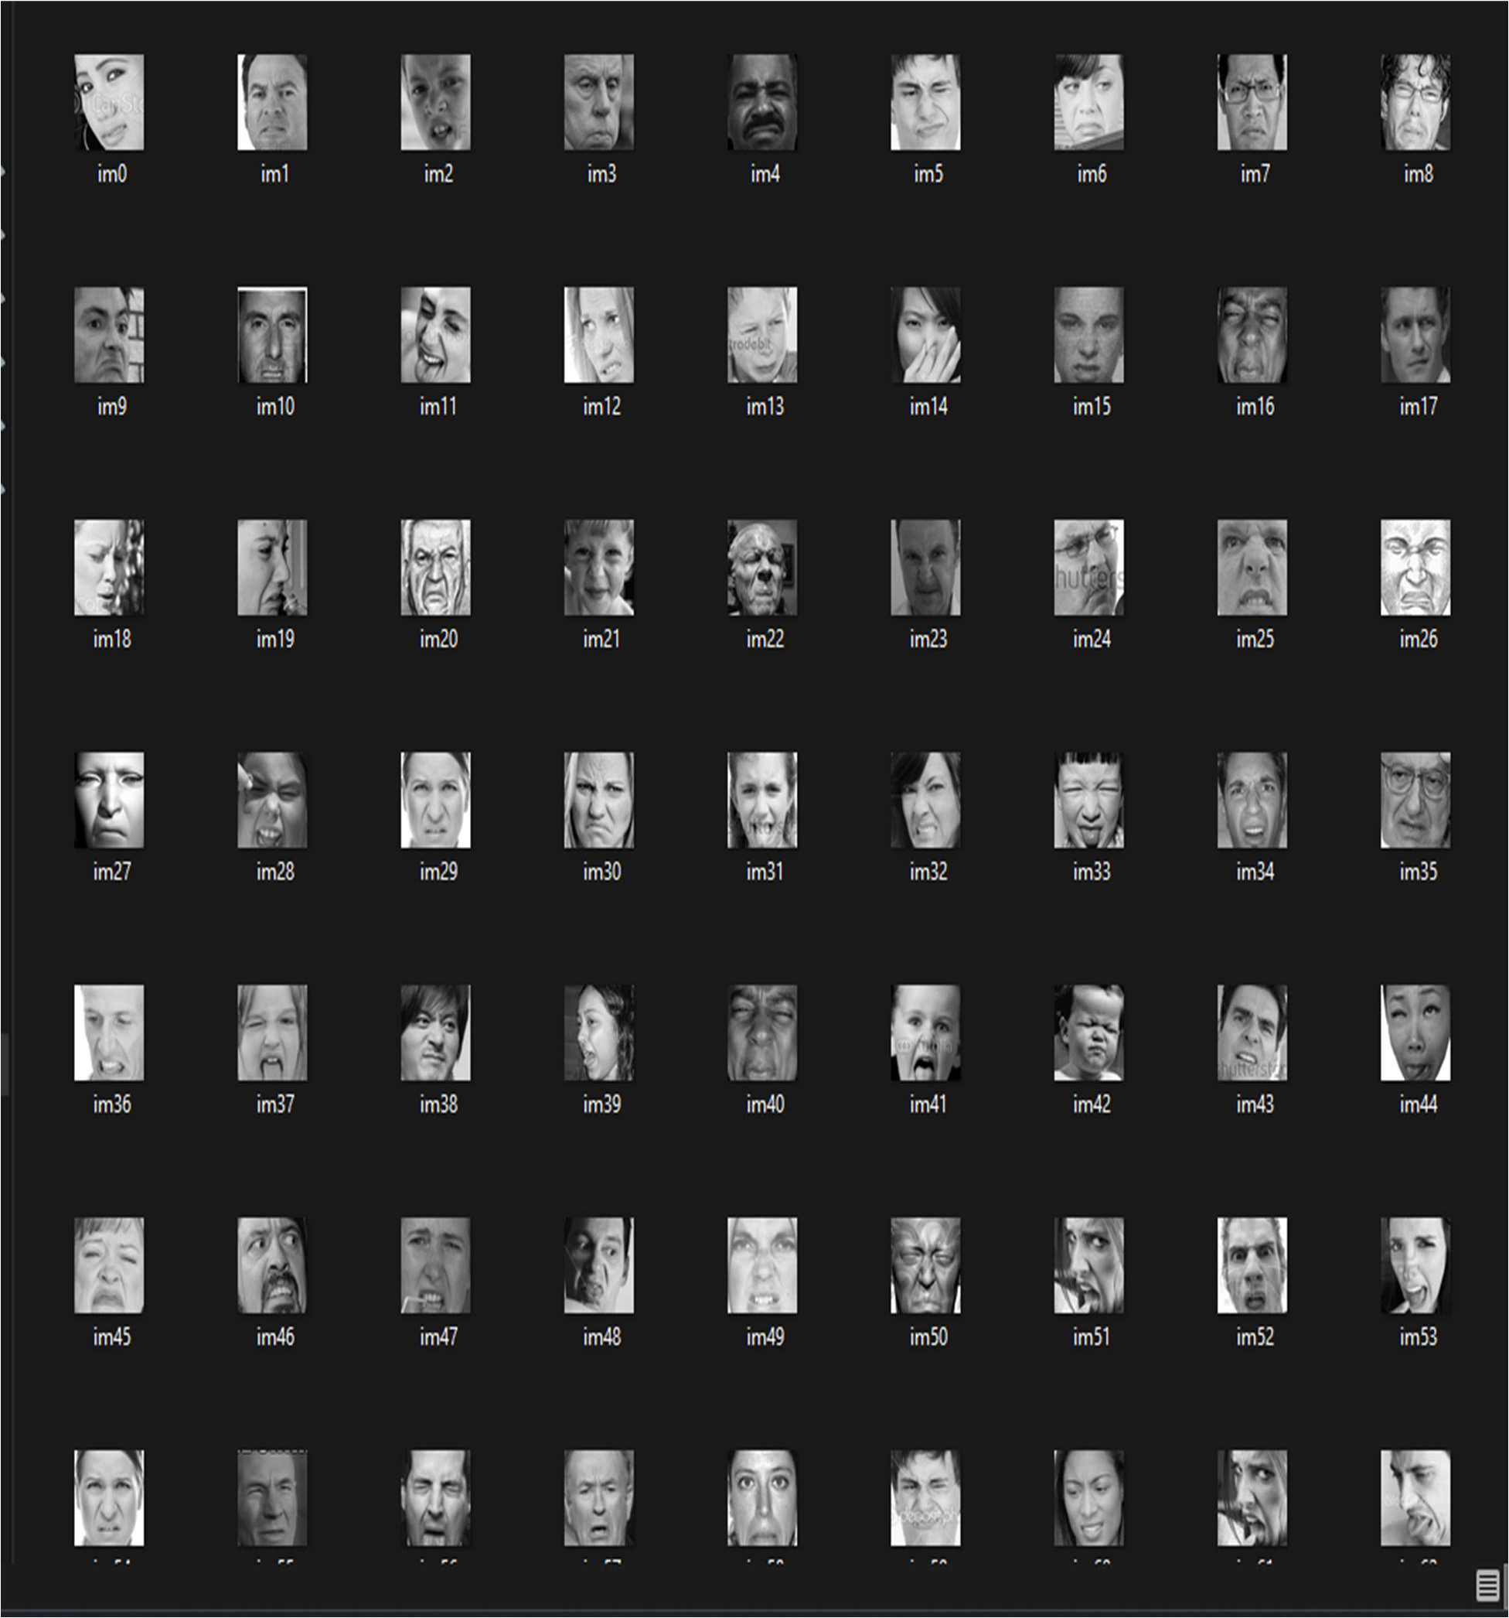
DATA SET
Image Dataset:
The dataset is labeled based on the different emotions expressed by the IT professionals. These emotions include anger, disgust, fear, happiness, neutral, sadness, and surprise. Each image in the dataset represents a specific individual displaying a particular emotion. The dataset is download from Kaggle and it contain 500 records. The objective is to develop a stress detection system using machine learning and image processing techniques. By training a model on the "train" and “test”dataset.
..

Slide 10


OUTPUT SCREENS
Homepage:
User registration form:

Slide 11


Admin Login form: Admin Home page:

Slide 12
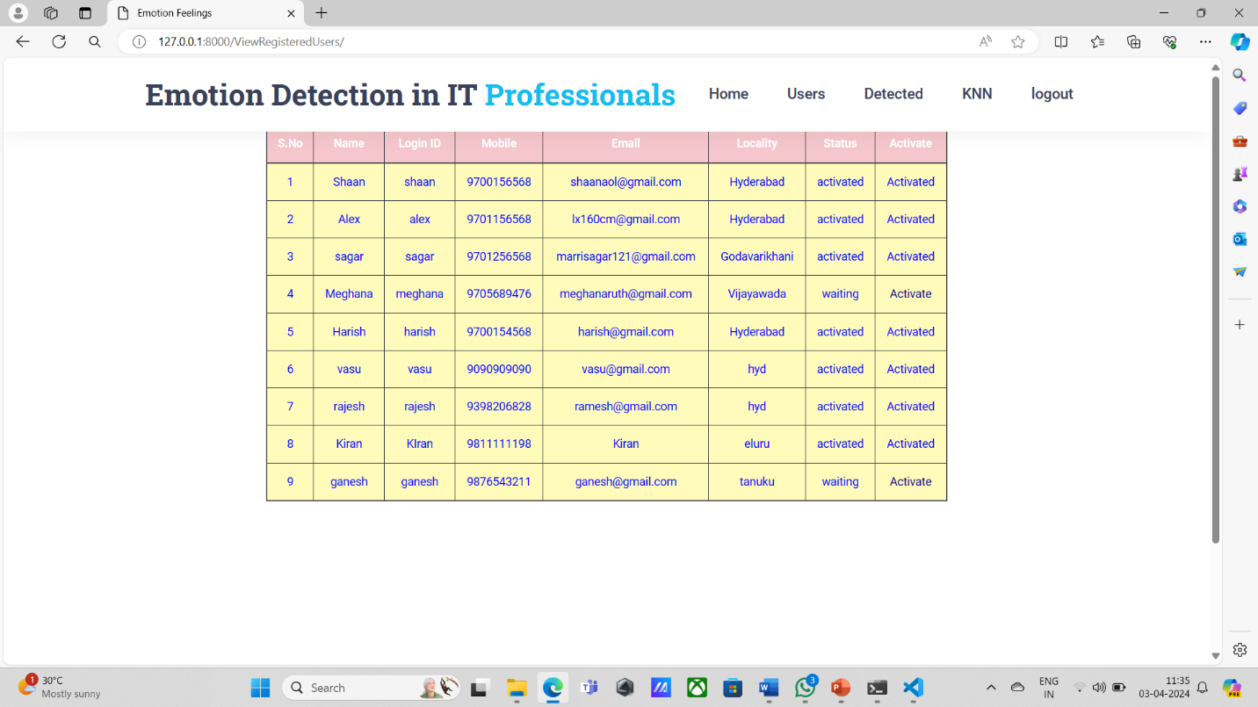
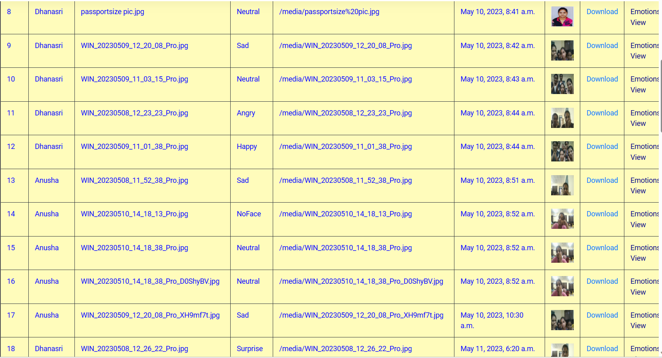
View Users and Activate: Admin side detection details:

Slide 13

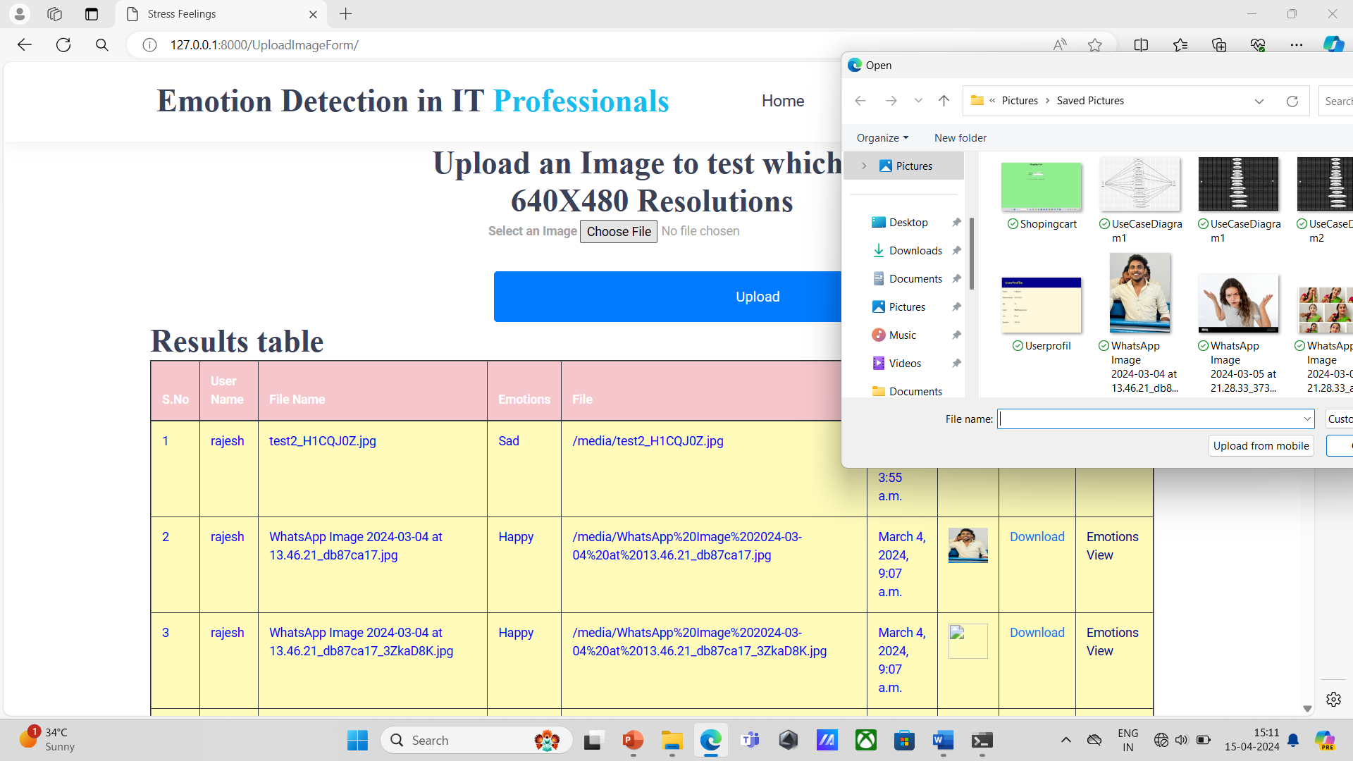
User Login Form: Emotion detection using image uploading:

Slide 14
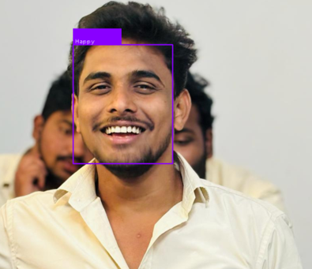
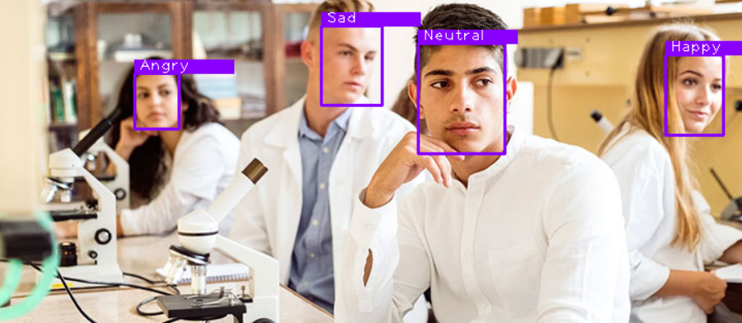
Image Detection :

Slide 15
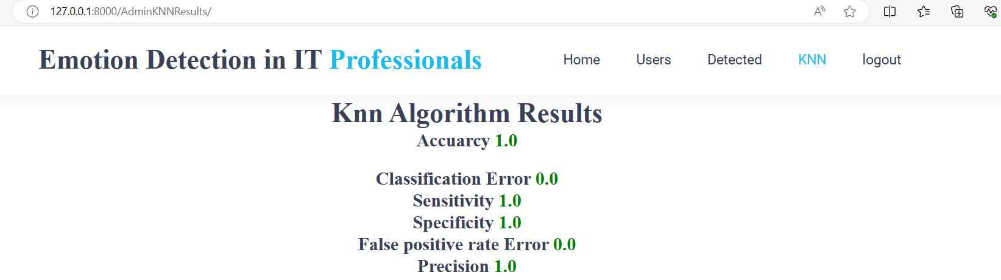
KNN Result:

Slide 16
Conclusion
Emotion Detection System is designed to predict Emotion in the employees by monitoring captured images of authenticated users which makes the system secure. The image capturing is done automatically when the authenticate user is logged in based on some time interval. The captured images are used to detect the stress of the user based on some standard conversion and image processing mechanisms. Then the system will analyse the stress levels by using Machine Learning algorithms which generates the results that are more efficient.

Slide 17


